Slide 1

eLECTRONIC COMPASS
Embedded lab project demonstration

Slide 2
Data progression
Latitude and longitude
GPS
Distance and bearing
Processed by Haversine formula
Vector!
To point towards destination

Slide 3
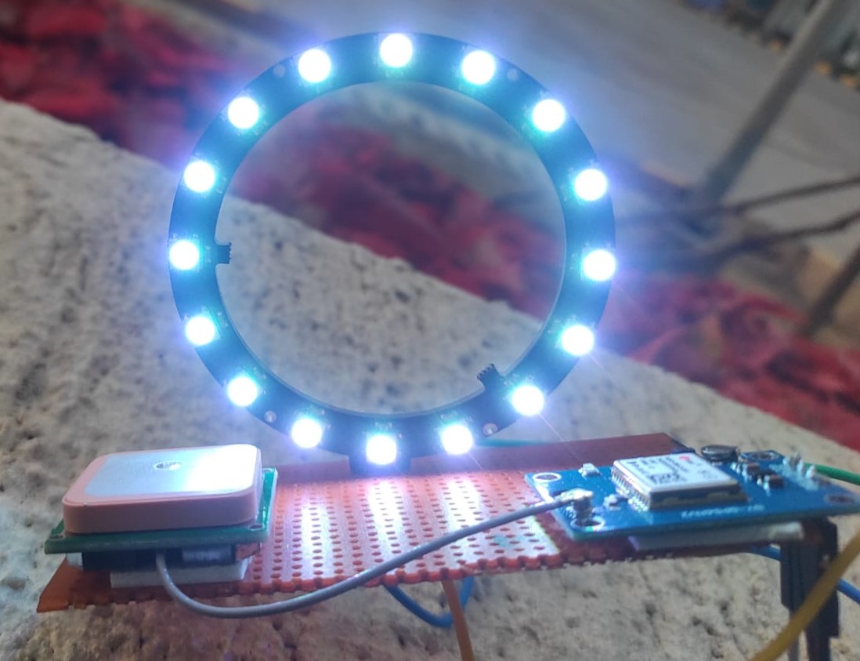
Electronic compass Prototype

Slide 4
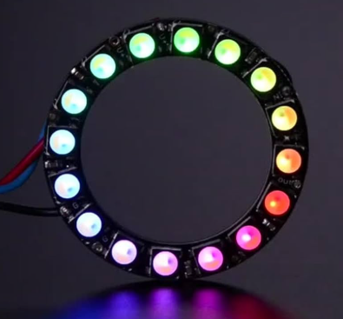
Working of the prototype
Extraction of latitude and longitude from the NEO GY-GPS module
Distance and bearing measurement between the prototype and the fixed location
Glowing LED’s on the ring, where each LED is assigned an angle range of 22.5 degrees

Slide 5
Thank you

